Slide 1


Slide 2
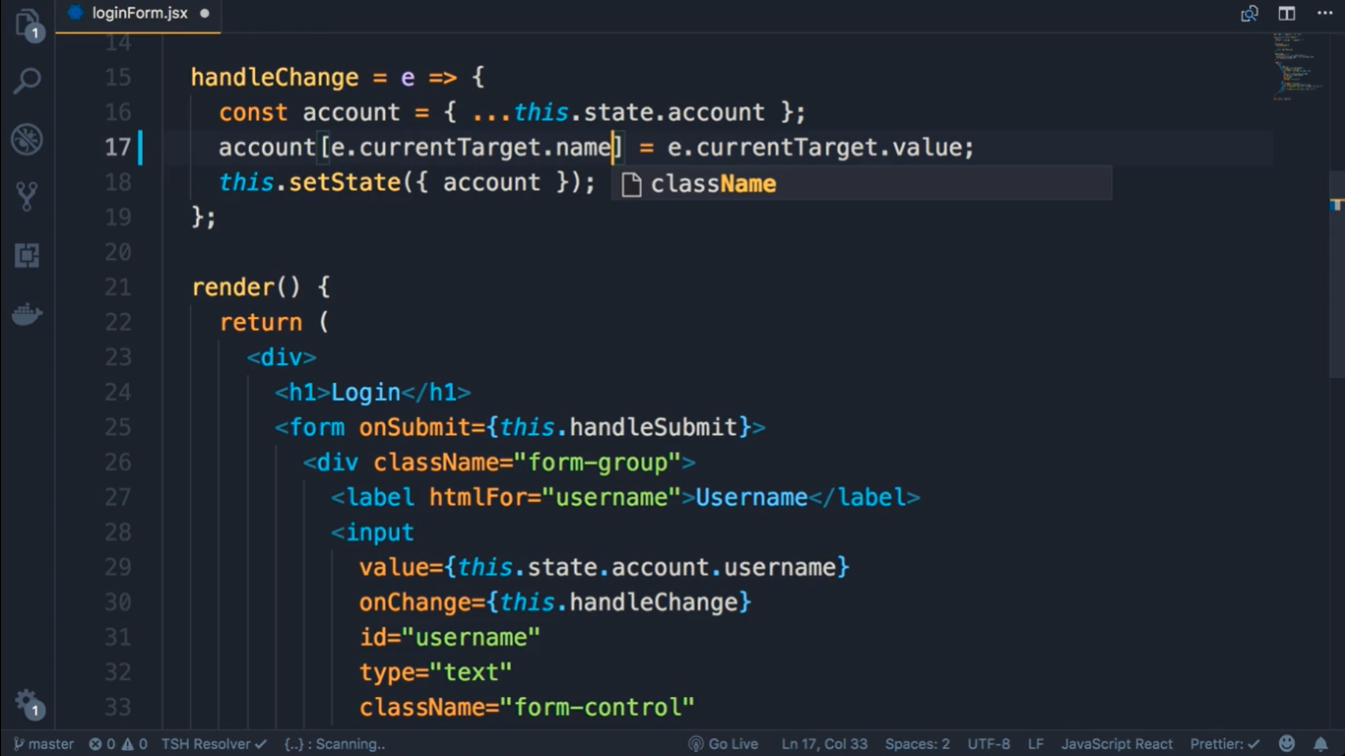

Slide 3
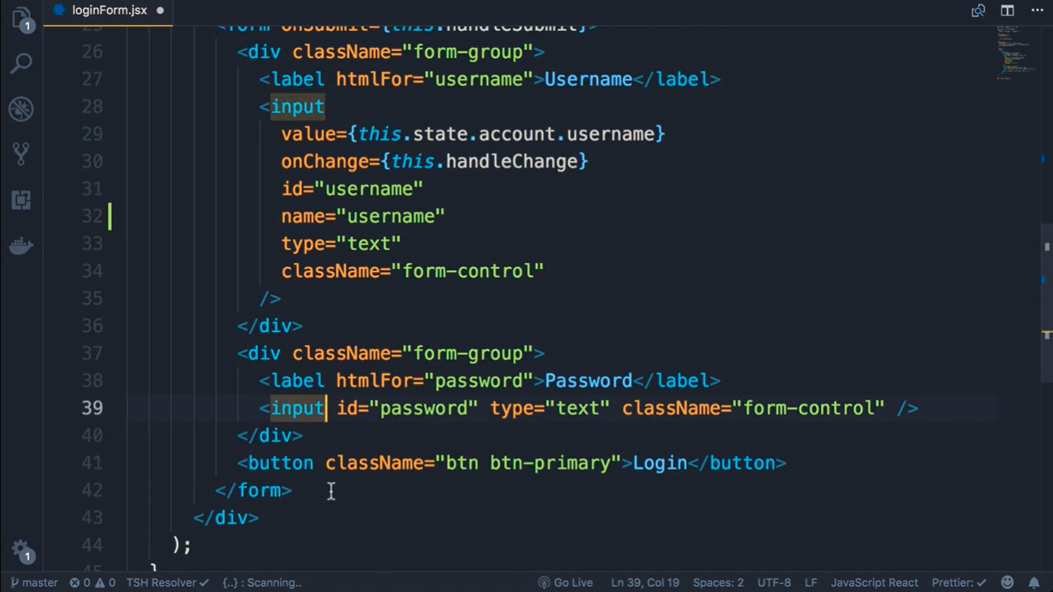
Name=“username”

Slide 4
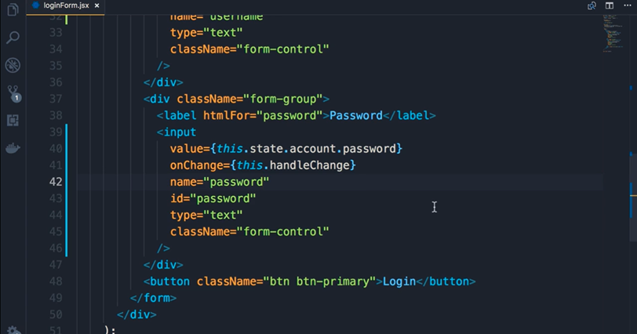

Slide 5
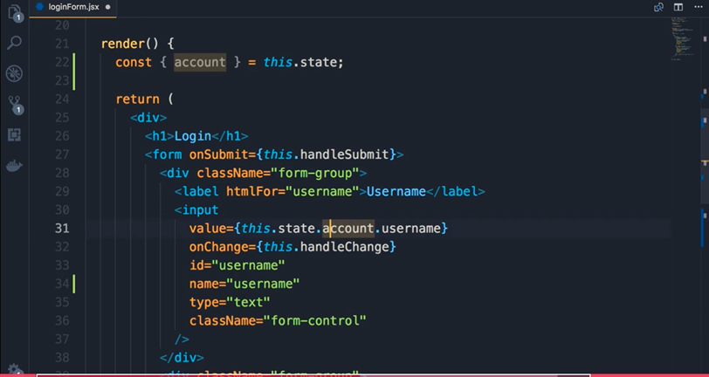

Slide 6
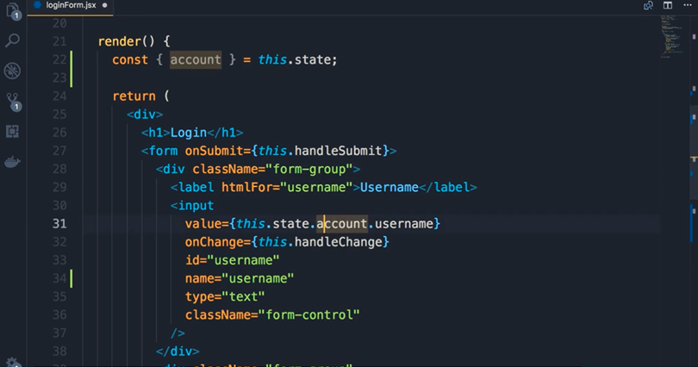
Remove this.state from username and password

Slide 7
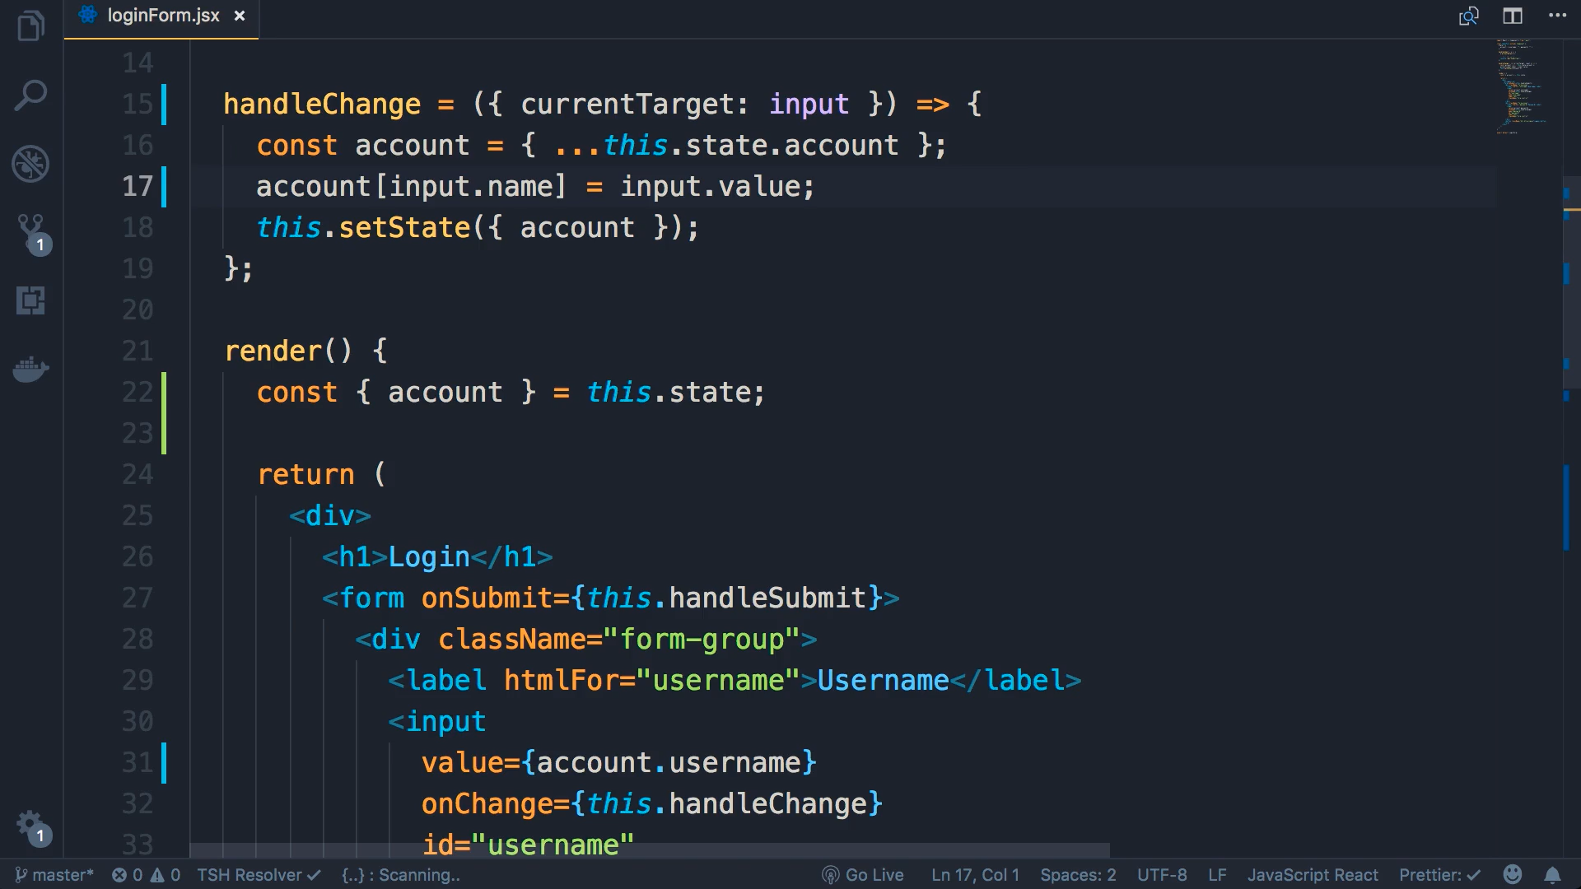
Destruct e.currentTarget with parameter CurrentTartget:input

Slide 8
